Slide 1
External Material Implementation of Mazars Damage Model

Slide 2
External Materials in COMSOL Multiphysics
User-defined material models written in C-code can be used in COMSOL Multiphysics through an External Materials socket
This allows you to program your own material models and distribute them as add-ons
The code needs to be compiled into a shared library (e.g., dll for Windows)
Use on Linux and Mac OS X requires recompilation of the source code
For further details, see the section Working with External Materials in the COMSOL Multiphysics Reference Manual as well as the section Using External Materials in the documentation of the Structural Mechanics Module.
The latter also includes documentation of a library of utility functions that is available in order to simplify the implementation

Slide 3
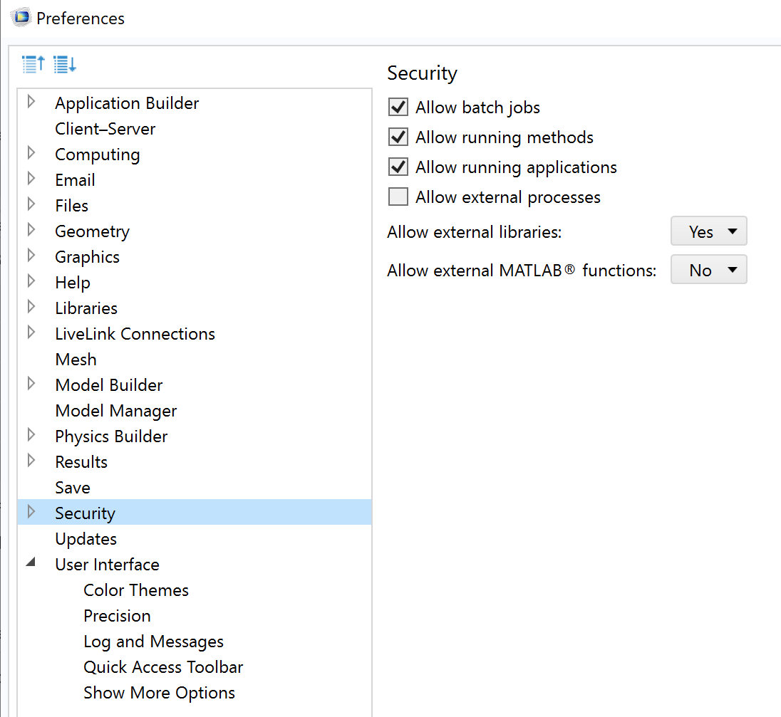
Working with External Materials in COMSOL Multiphysics
Before starting, go to File->Preferences->Security and set “Allow external libraries” to Yes.
For security reasons, external processes and libraries are disabled by default in a new COMSOL Multiphysics installation

Slide 4
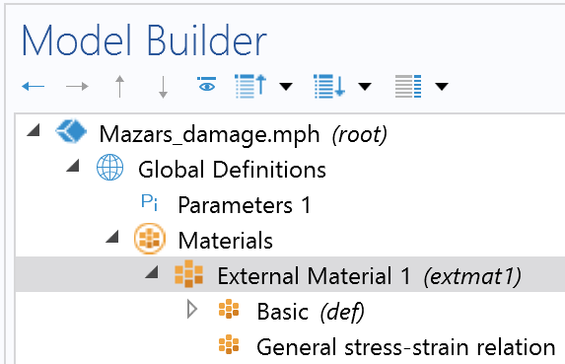
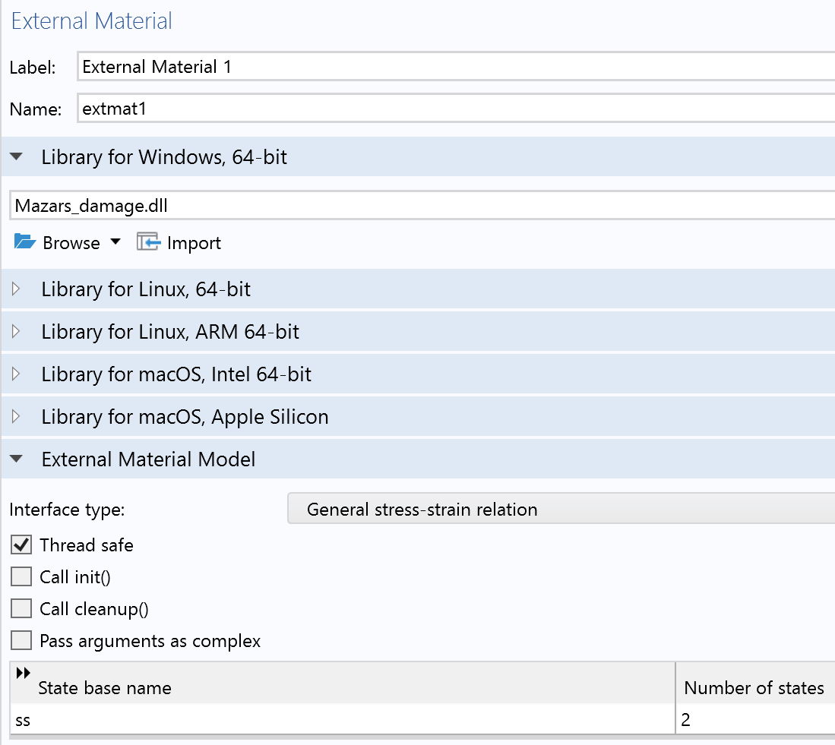
Linking an External Material
In the Materials node under Global Definitions, add an External Material
In the settings window, link the shared library according to the system architecture
Select the interface type according to the type of material relation you have implemented
Add the state variables as arguments
ss : state variable vector containing the maximum equivalent strain and the damage variable

Slide 5
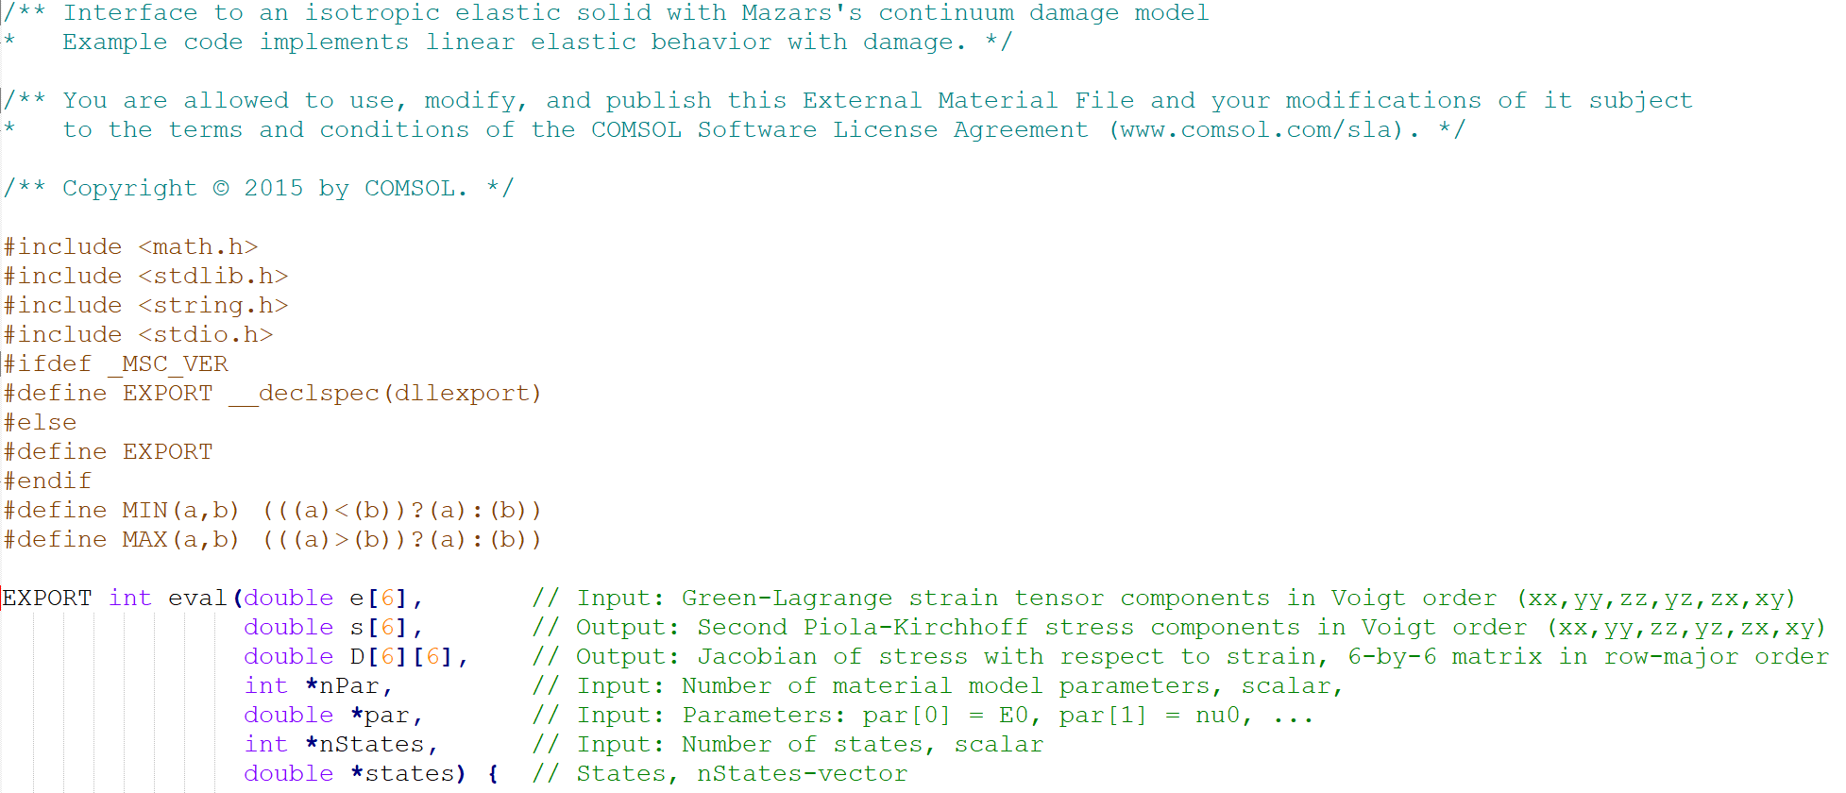
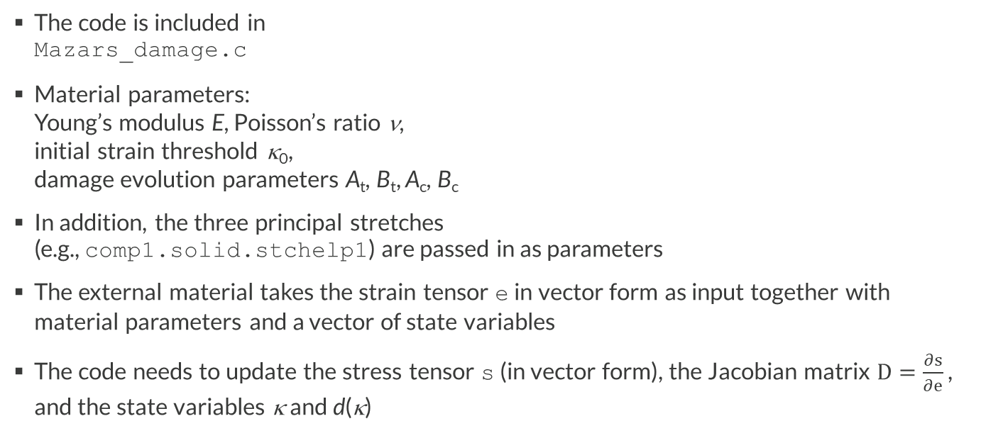
Example: Mazars Damage Model for Concrete
The code is included in Mazars_damage.c
Material parameters: Young’s modulus E, Poisson’s ratio ν, initial strain threshold κ₀, damage evolution parameters A_{t}, B_{t}, A_{c}, B_{c}
In addition, the three principal stretches (e.g., comp1.solid.stchelp1) are passed in as parameters
The external material takes the strain tensor e in vector form as input together with material parameters and a vector of state variables
The code needs to update the stress tensor s (in vector form), the Jacobian matrix $D=\frac{∂s}{∂e}$ , and the state variables κ and d(κ)

Slide 6
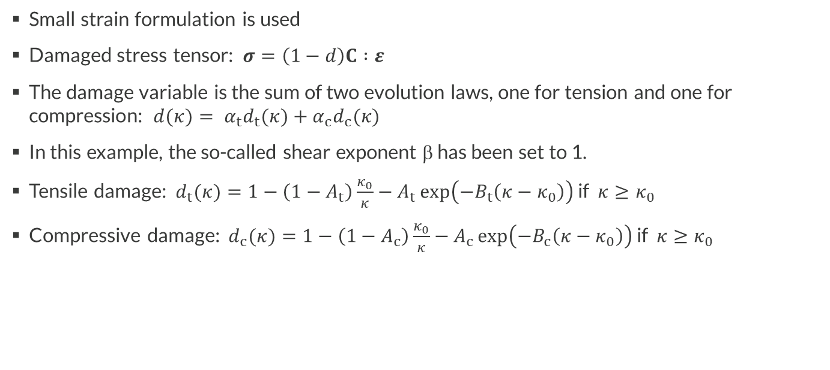
Constitutive Equations
Small strain formulation is used
Damaged stress tensor: $σ=\left(1−d\right)C :ε$
The damage variable is the sum of two evolution laws, one for tension and one for compression: $d(κ)= α_{t}d_{t}(κ)+α_{c}d_{c}(κ)$
In this example, the so-called shear exponent β has been set to 1.
Tensile damage: $d_{t}(κ)=1−\left(1−A_{t}\right)\frac{κ_{0}}{κ}−A_{t}\exp\left(−B_{t}\left(κ−κ_{0}\right)\right)$ if $κ≥κ_{0}$
Compressive damage: $d_{c}(κ)=1−\left(1−A_{c}\right)\frac{κ_{0}}{κ}−A_{c}\exp\left(−B_{c}\left(κ−κ_{0}\right)\right)$ if $κ≥κ_{0}$

Slide 7
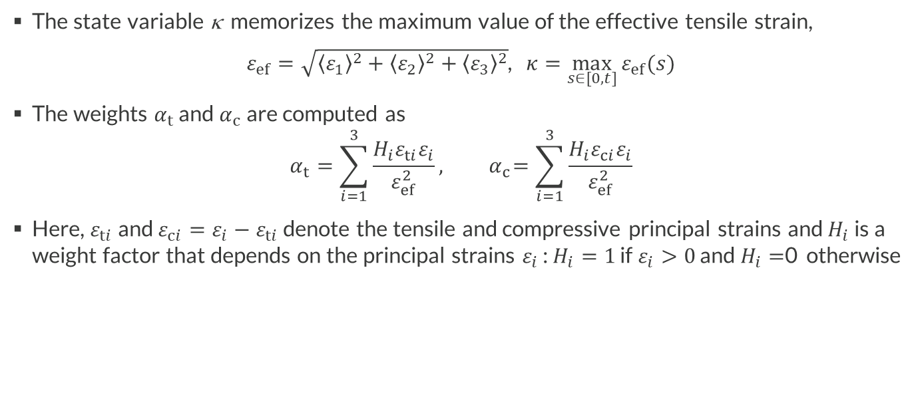
Constitutive Equations
The state variable κ memorizes the maximum value of the effective tensile strain,
$ε_{ef}=\sqrt{{\left\langle ε_{1}\right\rangle }^{2}+{\left\langle ε_{2}\right\rangle }^{2}+{\left\langle ε_{3}\right\rangle }^{2}}$, $κ=\max_{s∈[0,t]}{ε_{ef}(s)}$
The weights $α_{t}$ and $α_{c}$ are computed as
$$α_{t}=\sum_{i=1}^{3}{\frac{H_{i}ε_{ti}ε_{i}}{ε_{ef}^{2}}},{ α}_{c}=\sum_{i=1}^{3}{\frac{H_{i}ε_{ci}ε_{i}}{ε_{ef}^{2}}}$$
Here, $ε_{ti}$ and $ε_{ci}=ε_{i}−ε_{ti}$ denote the tensile and compressive principal strains and $H_{i}$ is a weight factor that depends on the principal strains $ε_{i}$ : $H_{i}=1$ if $ε_{i}>0$ and $H_{i}=$0 otherwise

Slide 8
Validation with Built-in Implementation
The External Material code is validated against the built-in implementation of a Linear Elastic Material with Mazars damage model for concrete in COMSOL Multiphysics
The built-in version is available in the Damage subnode to Linear Elastic Material
Values for the material parameters are obtained from Torrenti, Pijaudier-Cabot, and Reynouard (eds), “Mechanical Behavior of Concrete”, Wiley, 2020.
To associate the External Material to a domain, add an External Stress-Strain Relation feature under the Solid Mechanics interface
The results from the two implementations are compared for a single-element model
Note that the External Stress-Strain Relation feature will force the study to be geometrically nonlinear; to force the use of small strains, enable the checkbox Geometrically linear formulation in the External Stress-Strain Relation settings window

Slide 9
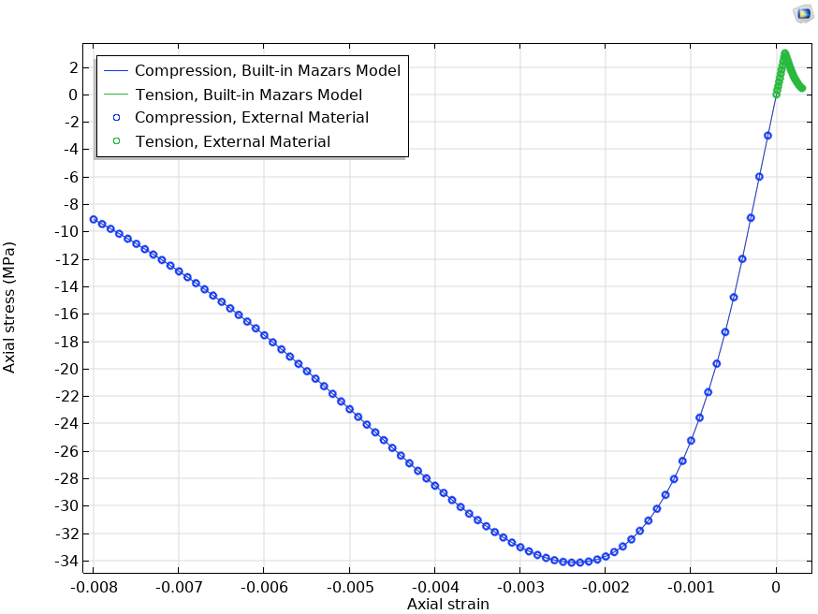
Results
Note: When using the built-in implementation, solid.sij denotes the ij-component of the undamaged stress tensor, whereas when using an External Material, the same variable denotes the damaged stress tensor. For a correct comparison between implementations, we therefore need to use the variables solid.sdij, which contain the components of the damaged stress tensor, for the built-in damage model

